Slide 1

Department of Cyber Security
2026-2027- Odd Semester
III Year /V Sem
CS23533-FOUNDATIONS OF ARTIFICIAL INTELLIGENCE
Review 1– 09.09.2026

Slide 2
Introduction
2
Emergency situations such as accidents, fires, medical emergencies, and crimes require quick and appropriate response.
Selecting the right emergency resource and reaching the incident location through an efficient route are important for reducing response delays.
Traditional emergency response systems may require manual decision-making for resource selection and route planning.
Our proposed system uses Classical AI techniques to support emergency resource allocation and route planning.
A knowledge-based rule system is used to select a suitable emergency resource based on the emergency type and location.
The A Search Algorithm* is used to calculate an efficient route between the selected resource and the emergency location.
The system provides the allocated resource, route information, distance, and route visualization through an interactive digital map.
[Department] | Project Review – 1 | [Academic Year]

Slide 3
Problem Statement
3
During emergencies, delayed resource allocation and inefficient route selection can affect the response process.
Selecting a suitable emergency resource such as an ambulance, fire service, or police vehicle may require quick decision-making.
Manual resource selection may not consistently consider the type and priority of the emergency.
Emergency vehicles need an efficient route from their current location to the emergency location.
Conventional approaches may not provide a single integrated platform for resource allocation and route planning.
Therefore, there is a need for a system that can automatically select an appropriate emergency resource and calculate an efficient route using Classical AI techniques.
[Department] | Project Review – 1 | [Academic Year]

Slide 4
Motivation
4
Project Selection:
Emergency response requires fast resource allocation and route planning.
The project applies Classical AI to a real-world emergency management problem.
Research / Industry Motivation:
Emergency services need suitable resources to be identified quickly.
A search* provides heuristic-based route planning over a road network.
Expected Benefits:
Faster and more systematic emergency resource selection.
Efficient route calculation and map-based route visualization.
Transparent and explainable AI-based decision making.
Practical Significance:
Provides a single platform for emergency type selection, resource allocation, and route planning.
Can serve as a prototype for ambulance, fire, and police emergency response systems.
[Department] | Project Review – 1 | [Academic Year]

Slide 5
Objectives
5
To develop an AI-based emergency resource allocation system that intelligently assigns the most appropriate emergency resource based on the type, priority, and location of an emergency.
To implement a knowledge-based decision-making mechanism using predefined rules for selecting suitable emergency resources such as ambulances, fire trucks, and police vehicles.
To utilize the A* search algorithm for identifying the shortest and most efficient route from the selected emergency resource to the incident location, thereby reducing response time.
To consider resource availability and road conditions during the allocation process to ensure efficient and practical emergency response.
To improve the speed, accuracy, and consistency of emergency resource allocation compared to conventional manual allocation methods.
To demonstrate the application of classical Artificial Intelligence techniques, including Intelligent Agents, Heuristic Search, and Knowledge-Based Reasoning, without relying on Machine Learning, Deep Learning, or Neural Networks.
[Department] | Project Review – 1 | [Academic Year]

Slide 6
Literature Survey
6
S.No. | Author & Year | Method / Technique | Key Findings | Limitations
1 | Nordin et al. (2012) | A* Search Algorithm | Developed an A*-based ambulance routing interface to find shortest-distance routes on a road network. | Mainly considers a static road network; real-time traffic and dynamically changing road conditions are not addressed.
2 | Mukhopadhyay et al. (2022) | Resource Allocation & Computer-Aided Dispatch | Reviewed incident prediction, detection, resource allocation and computer-aided dispatch approaches for emergency response management. | It is a survey/review, so it does not provide one single integrated implementation for real-time emergency resource allocation and routing
3 | Pettet et al. (2022) | Decision Support System | Proposed an emergency-response management framework involving incident detection, forecasting, strategic resource allocation and dispatch decisions | Covers a broad emergency-response pipeline; implementing all components together requires substantial data and system integration
[Department] | Project Review – 1 | [Academic Year]

Slide 7
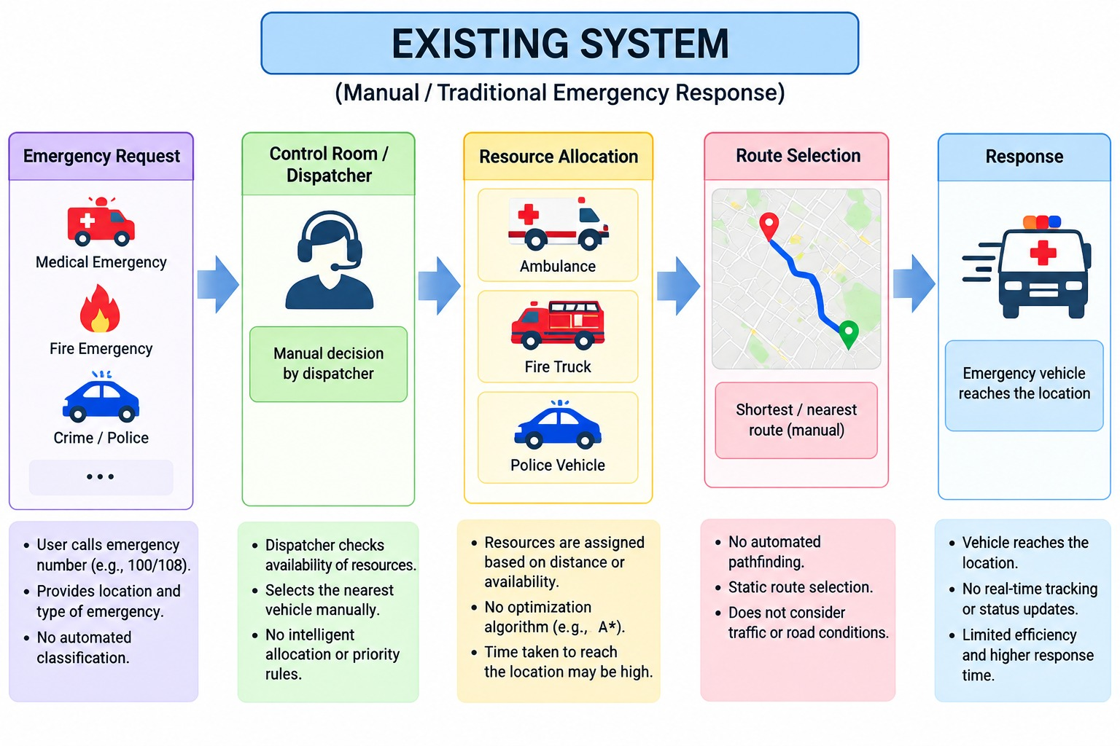
Existing System
7
Existing approach / technique:
Manual / conventional emergency resource allocation
Computer-Aided Dispatch (CAD) for emergency response
Shortest-path routing using A* Search Algorithm
Decision Support Systems for emergency management
Existing technologies or algorithms:
A* Search Algorithm – shortest-path route calculation
Computer-Aided Dispatch (CAD) – emergency resource dispatch
Resource Allocation Models – assigning appropriate emergency resources
Decision Support Systems (DSS) – supporting emergency response decisions
OpenStreetMap-based road network – geographical road data
Advantages:
Shorter Route | Faster Dispatch | Systematic Allocation | Decision Support
Limitations:
Static Data | Limited Real-Time Updates | Separate Systems | Data Dependency
[Existing System Diagram / Screenshot]
[Department] | Project Review – 1 | [Academic Year]

Slide 8
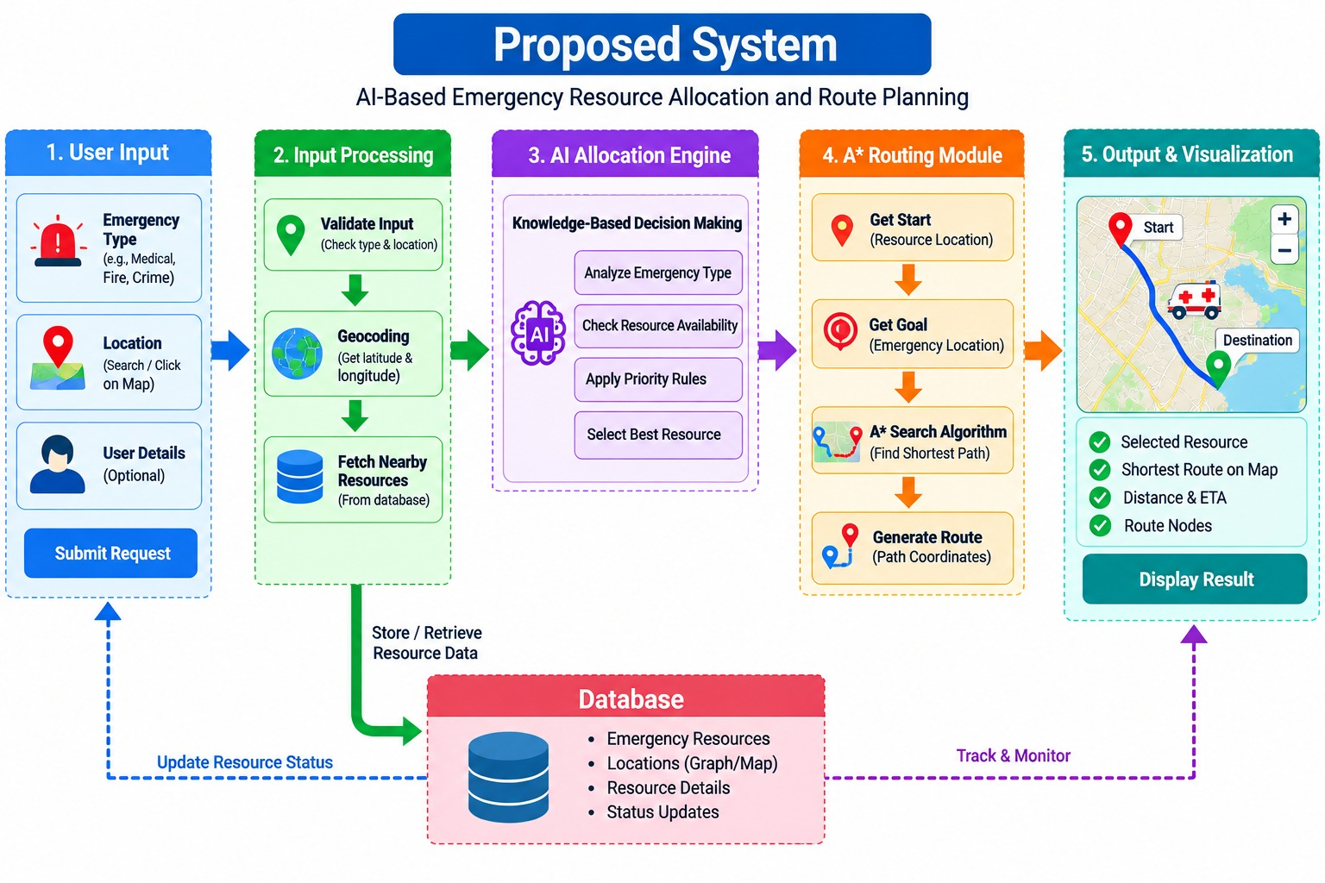
Proposed System
8
Proposed approach:
AI-based emergency resource allocation
A* shortest-path routing
Key features / innovations:
Automatic resource selection
Location-based emergency routing
Interactive map visualization
Real-time route display
How it improves the existing system:
Combines allocation and routing
Reduces manual processing
Provides faster route planning
Expected outcome:
Faster emergency response
Efficient resource utilization
Accurate route guidance
[Proposed System Diagram]
[Department] | Project Review – 1 | [Academic Year]

Slide 9
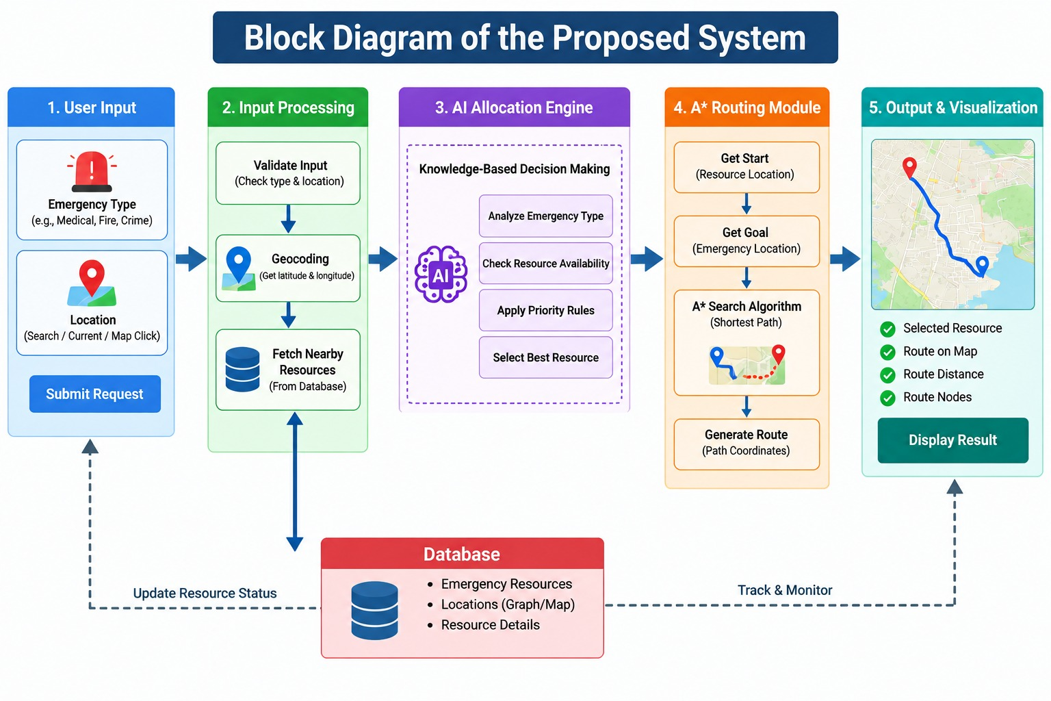
System Architecture / Block Diagram
9
[Department] | Project Review – 1 | [Academic Year]

Slide 10
Methodology
10
1. Collect emergency type and location details.
2. Validate the selected emergency location and coordinates.
3. Analyze the emergency and determine the required resource.
4. Allocate a suitable resource such as an ambulance, fire unit, or police unit.
5. Use A* Search to calculate the shortest route from the resource to the emergency location.
6. Display the allocated resource, route, distance, and emergency details on the map.
[Department] | Project Review – 1 | [Academic Year]

Slide 11
Technologies Used
11
HTML/CSS/JavaScript – Builds the user interface.
Leaflet.js + OpenStreetMap – Displays the interactive map and locations.
Python + Flask – Handles backend processing and API requests.
A* Search Algorithm – Finds the shortest emergency route.
OSMnx + NetworkX – Provides the road network and performs route calculation.
Nominatim API – Searches locations and obtains coordinates.
JSON – Transfers data between frontend and backend.
Visual Studio Code – Used for project development.
[Department] | Project Review – 1 | [Academic Year]

Slide 12
Module Description
12
Module 1 – Emergency Input & Location
index.html • map.js
Collects emergency type and location using map selection, current location, or location search.
Module 2 – Resource Allocation
resource_allocator.py
Analyzes the emergency type and selects a suitable available emergency resource.
Module 3 – A Routing*
astar.py • NetworkX • OSMnx
Uses the A* algorithm to calculate the shortest route from the resource location to the emergency location.
Module 4 – Map Visualization
map.js • Leaflet.js • OpenStreetMap
Displays the emergency location, resource location, and calculated route on the interactive map.
Module 5 – Backend & API Integration
app.py • Flask • JSON
Connects the frontend with resource allocation and A* routing, and returns the final emergency response details.
[Department] | Project Review – 1 | [Academic Year]

Slide 13
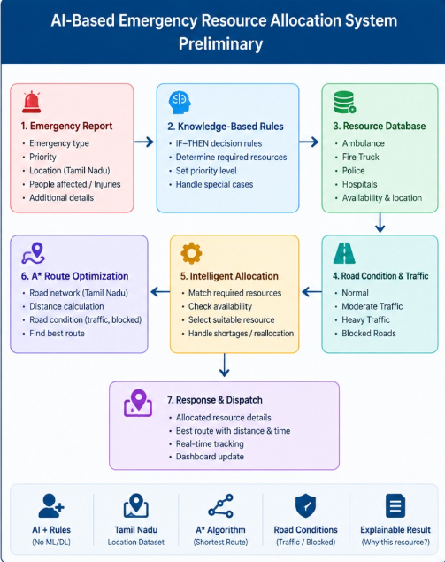
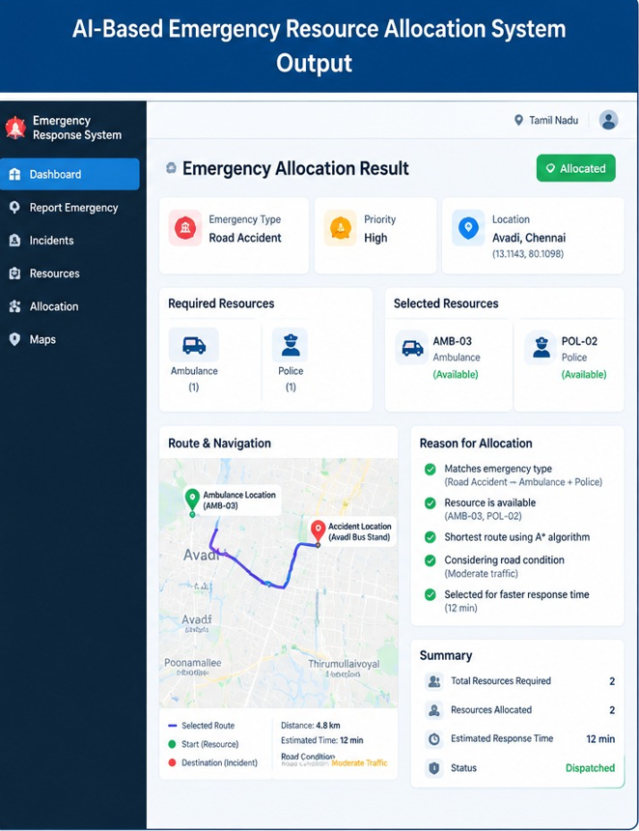
Preliminary /Output
13
[Insert Screenshot / Table]
[Department] | Project Review – 1 | [Academic Year]

Slide 14
Project Schedule
14
Activity | Month 1 | Month 2 | Month 3 | Month 4
Literature Survey | ✓ | ✓ | _ | _
Problem Identification | ✓ | _ | _ | _
System Design | _ | ✓ | ✓ | _
Implementation | _ | _ | ✓ | ✓
Testing & Evaluation | _ | _ | _ | ✓
[Department] | Project Review – 1 | [Academic Year]

Slide 15
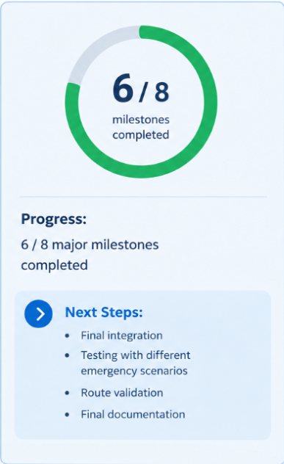
Current Progress
15
✓ Literature survey and problem identification completed
✓ Requirement analysis and methodology finalized
✓ System architecture and module design completed
✓ Frontend map interface implemented
✓ Flask backend and resource allocation implemented
✓ A* shortest-path routing integrated
☐ Complete system testing and debugging
☐ Performance evaluation and documentation
[Department] | Project Review – 1 | [Academic Year]

Slide 16
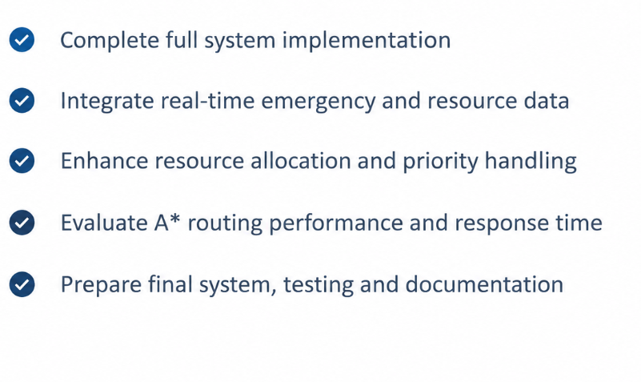
Future Work
16
[Department] | Project Review – 1 | [Academic Year]

Slide 17
Conclusion
17
The proposed system combines AI-based resource allocation with A* pathfinding for emergency response.
It identifies the emergency type, priority, and suitable emergency resource based on the given location.
Leaflet and OpenStreetMap provide an interactive map for selecting and searching emergency locations.
The A* algorithm calculates an efficient route from the selected resource location to the emergency location.
The system provides route distance, resource details, priority, and map-based visualization to support faster emergency decision-making.
The expected outcome is a simple, efficient, and user-friendly emergency resource allocation and routing system.
[Department] | Project Review – 1 | [Academic Year]

Slide 18
References
18
N. A. M. Nordin, Z. A. Zaharudin, M. A. Maasar, and N. A. Nordin, "Finding Shortest Path of the.Ambulance Routing: Interface of A Algorithm Using C# Programming,"* in Proceedings of the 2012 IEEE Symposium on Humanities, Science and Engineering Research (SHUSER), Kuala Lumpur, Malaysia, June 24–27, 2012, pp. 1569–1573,https://ieeexplore.ieee.org/document/6268841
J. Barrachina, P. Garrido, M. Fogue, F. J. Martínez, J.-C. Cano, C. T. Calafate, and P. Manzoni,"Reducing Emergency Services Arrival Time by Using Vehicular Communications and EvolutionStrategies," Expert Systems with Applications, vol. 41, no. 4, pp. 1206–1217, Mar. 2014,https://doi.org/10.1016/j.eswa.2013.08.004
G. Pettet, A. Mukhopadhyay, M. J. Kochenderfer, and A. Dubey, "Hierarchical Planning for Resource Allocation in Emergency Response Systems," in Proceedings of the 12th ACM/IEEE International Conference on Cyber-Physical Systems (ICCPS 2021), Nashville, TN, USA, May 2021, https://doi.org/10.1145/3450267.3450543
[Department] | Project Review – 1 | [Academic Year]

Slide 19
THANK YOU
Questions & Suggestions

